Slide 1
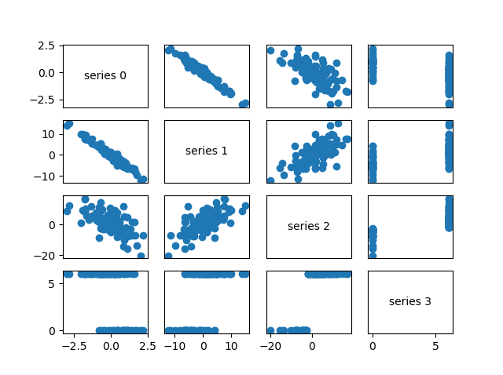
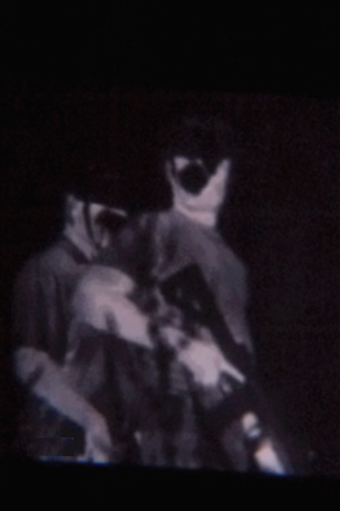
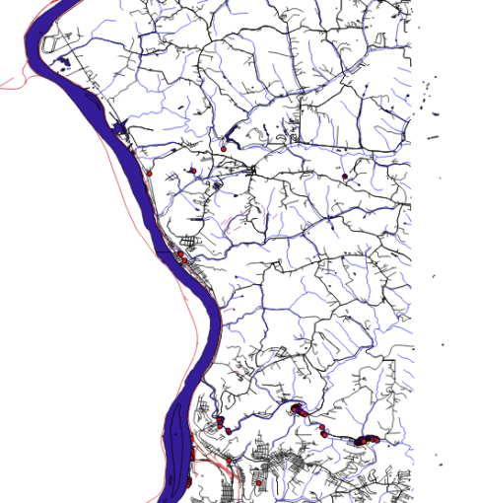
Intelligent Operations
Intelligent Operations
NeuroMachina Internal Research Project
Focus Area: Tactical, Integrated Robotically Enhanced Network/Secure (TIRYNS)

Slide 2
TIRYNS Portable Sensory Environment
CSI
Wifi
Mobile Wifi
PYTHON
Rpi.GPIO
PyUSB
Picamera
Opencv
GDAL/OGR
SKLearn
Dlib
Sockets
Image classification
Geospatial analytics
Encryption
Equipment
Cameras
Microphone
Motion Detect
Anemometer
Range Finder
Temp/Humid
Altimeter
Heater/Fan
GPIO
Analysis
Motion detected
Number of Tangos
Direction of march
Interdiction path
Line of sight analysis
Sensory enhanced video
Distance to target
Wind speeds
Elevation
Temp/humid
Cover or concealed positions
USB
DEM
Geospatial Database
October 1, 2018
Recceplex Machines

Slide 3
Communications Environment
Mobile Wifi (802.11)
P25 radios (Homeland Security Agencies, Police, Foreign Military)
GNU Radio
PYTHON
MIMO
USRP
PRC 152
Software Option
DoD Tactical Networks
JTRS/SCA compliant Future Communications Networks
October 31, 2018
Recceplex Machines

Slide 4
GPU Cluster Environment
WIFI
Mobile Wifi
AWS
PYTHON
Sockets
Send Image
Recv Class
PYTHON
Sockets
CNN Match CUDA
nVidia
GPU Cluster
PYTHON
Sockets
CNN Train
CUDA
nVidia
GPU Cluster
October 31, 2018
Recceplex Machines

Slide 5
TIRYNS
Threat Detection
Face, torso, profile, pedestrian with IR/RGB Fusion
Motion detection
Sound detection
Speech recognition (vs speaker recognition) by language
Thermal Imaging
Tactical Protocol
Real-time Alert Mode
Log mode
Archive Mode
Send just aggregates
Send just video/audio
Send both aggregates and video/audio
Heartbeat/restart
October 1, 2018
Recceplex Machines

Slide 6
TIRYNS
Detector Modeling Process
Supports cameras that use camera serial interface (CSI) or USB
Uses Intel’s OpenCV, largely open source library
Build or update a training set (photos of category to identify)
Encode vectors
Recognize category in image
Recognize category in video
Pickle model
Test
Microphone with amplifiers
Motion detector
Connect signal lead from motion detector to pin on GPIO board
Python program reads the pin
Starts camera on high signal from GPIO pin
October 1, 2018
Recceplex Machines

Slide 7
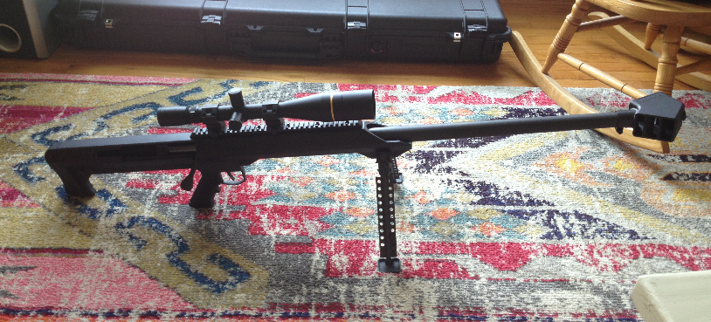
TIRYNS
Long range precision rifle support
Anemometer
Range finder
Temp/humid
Range finding, wind speed, temp, elev, humid
Maintain ballistic tables
Maintain shot log
October 1, 2018
Recceplex Machines

Slide 8
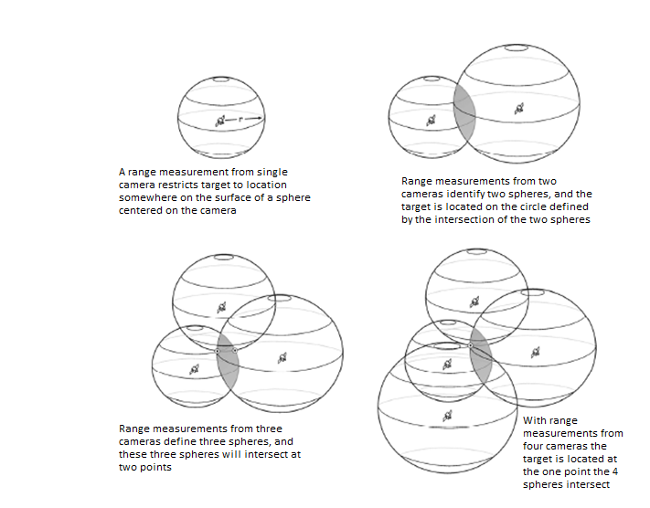
Target Location with TIRYNS Cameras
October 1, 2018
Recceplex Machines

Slide 9
Analytics for Security Environments
NeuroMachina, is developing analytics across many data sources in order to:
enhance detections of threats through multiple technologies
analyze patterns of activity in and around the area of operations
understand features use for area of operation
correlate geoanalytic demographics and historical trends with threat activity to provide insight into current and expected activity levels
predict threat destinations and routes based on historic data
enhance operator safety in hostile environments

Slide 10

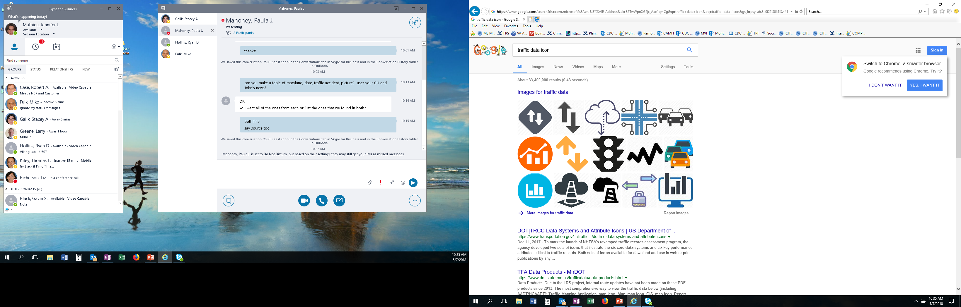

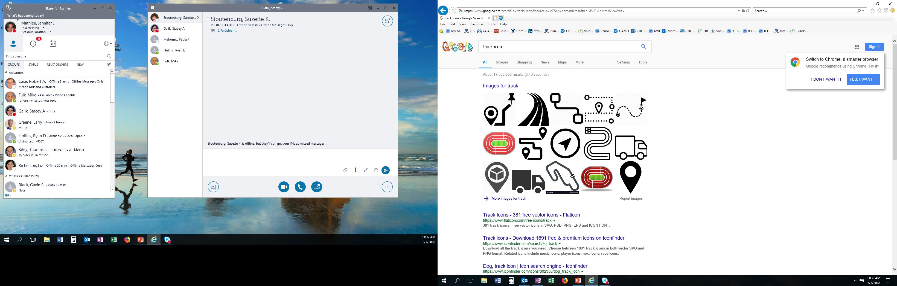


Intelligent Operations Analytics
Data Types
Data Type Analytics
Pattern/Trend Analysis
Results
Predictive Analytics
Course of Action Analysis
T
Text
Text Analytics
Disruptive Events
Image Video
Image/Video Analytics
Pattern Detection
Pattern Forecast
Traffic Analytics
Area Patterns
Traffic Data
Response Models
Imagery
Imagery Analytics
Location Analytics
Entity Patterns
Trajectory Models
Trajectory Forecast
Tracks
Sensor
Sensor Analytics
TIRYNS Environment

Slide 11















Analytics for Resilient Operations
AO Patterns and Trends
Route
Prediction
Patterns
of Use
Operation Risk
Environmentally Hazardous Areas
AO
Entry/Exit
Contextual Data
Social
Media
Weather
Safety
Incidents
Points of
Interest
Environmental
Areas
Threat Detection Across Sources
Radar
AIS
Video
Imagery
Acoustic

Slide 12
Focus Locations and Data Sources
Locations of Interest
Raster
Vector
Tirens Sensor Data
SRTM Imagery Data
USGS DEM Data
Weather Data & Forecasts
Threat Locations
Environmentally Hazardous Areas
Geolocated Social Media
Points of Interest
Battlefield Wrecks and Obstructions
Temperature & Related Data
Roadways
Notes:
Steve Scott is in collaboration with George Mason University’s School of Environmental Science and Public Policy Commerce). Presenting at International Institute of Fisheries Economics and Trade conference in Seattle later this summer.

Slide 13
TIRYNS Geospatial and Social Analytics
Attacks on law enforcement officers have increased materially in recent years:
Police deaths by criminal gunfire rose 53%
Ambush assaults on police rose 62%
Most military, law enforcement and emergency responder incidents have geographic, psychographic and demographic attributes
Planners can perform descriptive and predictive analytics by comparing incidents with coincident real-world characteristics
The multiple dimensions provided by these real-world characteristics mean that multiple models can be derived around an oepration
Strategies can be tailored to the specific context to which they should be applied
October 1, 2018
Recceplex Machines

Slide 14
DEmo
AO Eyes network camera
Force multiplication
Situational awareness
October 1, 2018
Recceplex Machines

Slide 15
DEmo
Geolocation on Rpi
Force multiplication
Situational awareness
October 1, 2018
Recceplex Machines

Slide 16
DEmo
Social Media Mining
Situational Awareness
Sense Making
October 1, 2018
Recceplex Machines

Slide 17
Image Datasets for Training
People Datasets
http://www-old.emt.tugraz.at/~pinz/data/GRAZ_01/
http://pascal.inrialpes.fr/data/human/
http://homepages.inf.ed.ac.uk/rbf/CVonline/Imagedbase.htm
http://homepages.inf.ed.ac.uk/rbf/CVonline/Imagedbase.htm#surveillance
https://storage.googleapis.com/openimages/web/index.html
http://chenlab.ece.cornell.edu/people/Andy/ImagesOfGroups.html
http://scikit-learn.org/stable/modules/generated/
(In Python ->) sklearn.datasets.fetch_lfw_people.html
https://www.cs.toronto.edu/~kriz/cifar.html
https://www.kaggle.com/datasets
https://cloud.google.com/bigquery/public-data/
http://www.image-net.org/
https://open.canada.ca/en/open-data
http://data.ottawa.ca/
https://towardsdatascience.com/image-datasets-for-artificial-intelligence-bbb12615edd7
http://www.cs.utexas.edu/~grauman/courses/spring2008/datasets.htm
October 31, 2018
Recceplex Machines

Slide 18
Image Datasets for Training
Ship Datasets
https://github.com/avaapm/marveldataset2016
http://www.dis.uniroma1.it/~labrococo/MAR/
Wikipedia Listed Datasets
https://en.wikipedia.org/wiki/List_of_datasets_for_machine_learning_research
October 31, 2018
Recceplex Machines

Slide 19
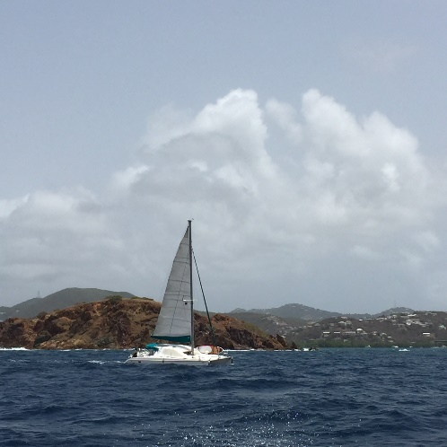
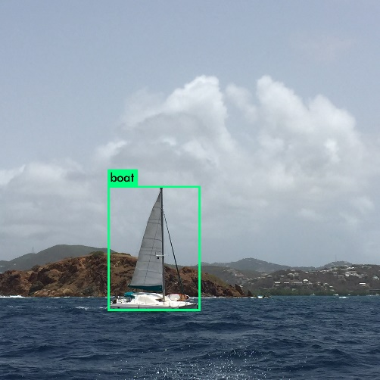

Threat Detection
Machine Learning on the Edge
Machine vision algorithms can be implemented on the edge to detect objects in near-realtime, reducing data load that must be transferred for server-side processing.
Object Detection using Raspberry Pi + Machine Vision
Raw Capture
Detection
Transfer
{ Boat : .7429 }
PiCamera captures photo or video.
Edge analytic on Pi detects object class.
Metadata and thumbnail streaming to server.
Notes:
Steve Scott is in collaboration with George Mason University’s School of Environmental Science and Public Policy Commerce). Presenting at International Institute of Fisheries Economics and Trade conference in Seattle later this summer.

Slide 20
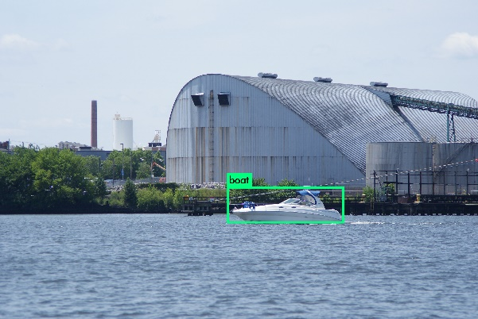
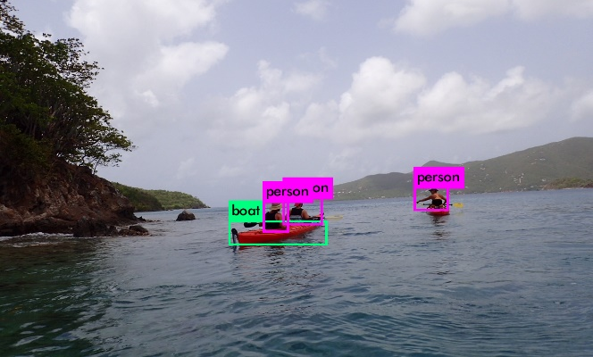
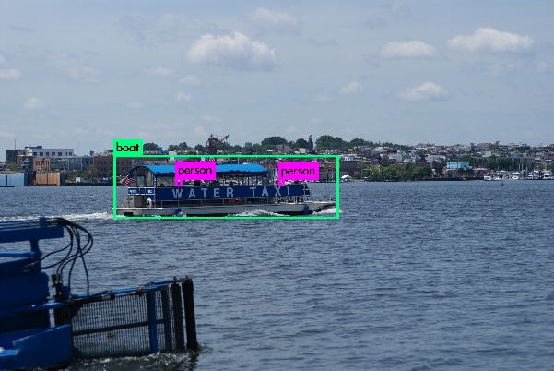
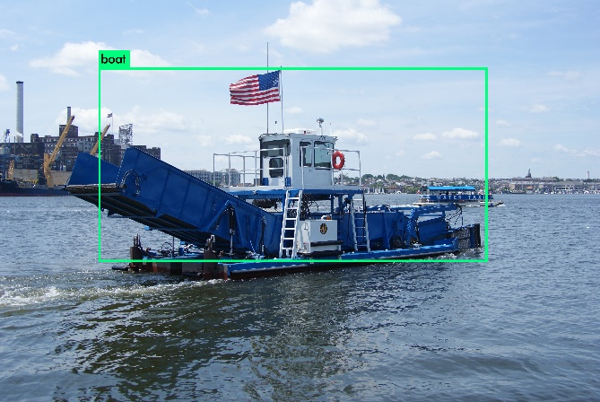
Threat Detection
Machine Learning on the Edge
Similar analytics and models can be deployed on the edge to detect marine debris, unsafe approaches, potential hazards, and other scenarios related to maritime safety.

Slide 21
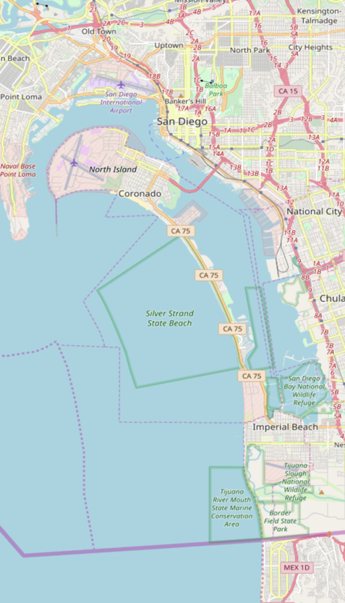
Focus: Movement Prediction
Area Pattern of Life
Pattern Detector
Entity Pattern of Life
Trajectory Models
Trajectory Forecast
In FY18, a Recurrent Neural Network (RNN) was applied to forecast marine vessel movements along routes to probable destinations
RNNs can also be applied to terrestrial vehicle data for various predictive tasks
RNNs have not only a static state, which could represent features like local geography and vehicle movement limitations, but also a dynamic state, which could represent a specific vehicle's previous behavior and other time-dependent variables
This unique architecture is well-suited for determining vehicle trajectories, destinations, and anomalous behaviors
likely
destination
predicted
path

Slide 22
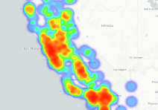
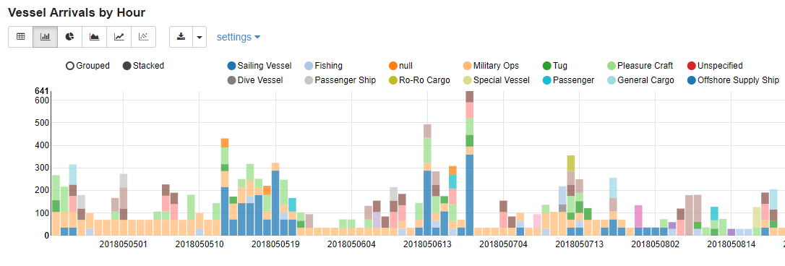
Focus: Port Trends
Analytics for maritime patterns and trends allow for characterization of port activity across hours, days, weeks, and months.
Analytics can inform patterns of use for specific areas, changes in trends and activities, and impacts of contextual events (weather, safety incidents) on vessel patterns.
Heatmap of vessel traffic off the West Coast.
MMSI Count
Hour (YYYMMDDHH)

Slide 23
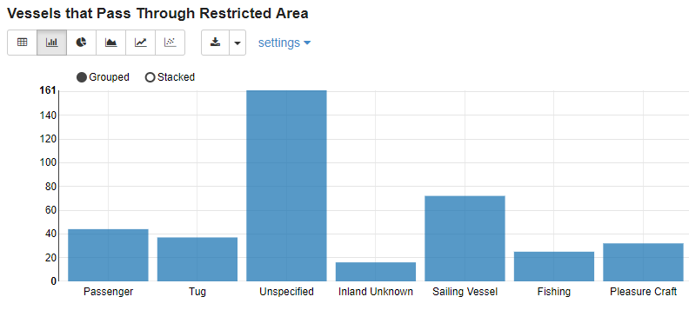
Focus: Environmentally Hazardous Areas
Analytics to analyze vessels entering hazardous environmental areas using Automatic Identification System (AIS) adversary locations and environmentally hazardous area polygons.
Analytics for areas of interest allow for characterization of adversaries and threat types entering, bivouacking, and travelling through hazardous environmental areas.
Available areas include polygons extracted from NOAA nautical charts.
Users can also enter a custom bounding box.
Vessels entering Environmentally Sensitive Area by type.

Slide 24
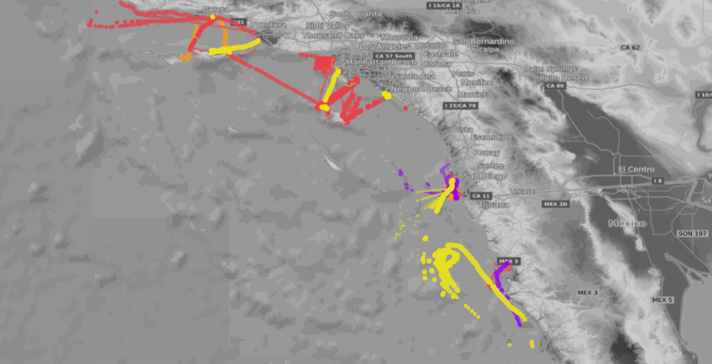
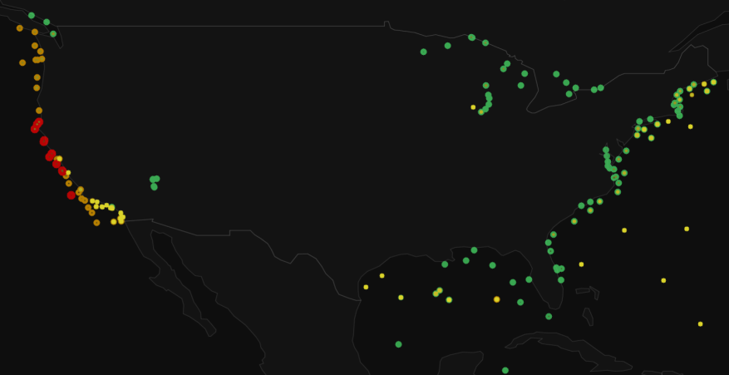
Focus: Weather and Vessel Activity
Analysis of weather and environmental conditions provide contextual information for vessel safety and impact on the environment.
Analytics can:
establish vessel safety risk given environmental conditions such as wave height
identify areas of increased risk due to environmental/weather factors
identify changing environmental conditions and potential impact on activities such as fishing
Fishing vessels colored by vessel length. Vessel length as 0m (yellow), 1 – 10m (orange), 10 – 12 (red), and over 20m (purple).
~800 Global NOAA buoys colored by wave height.

Slide 25
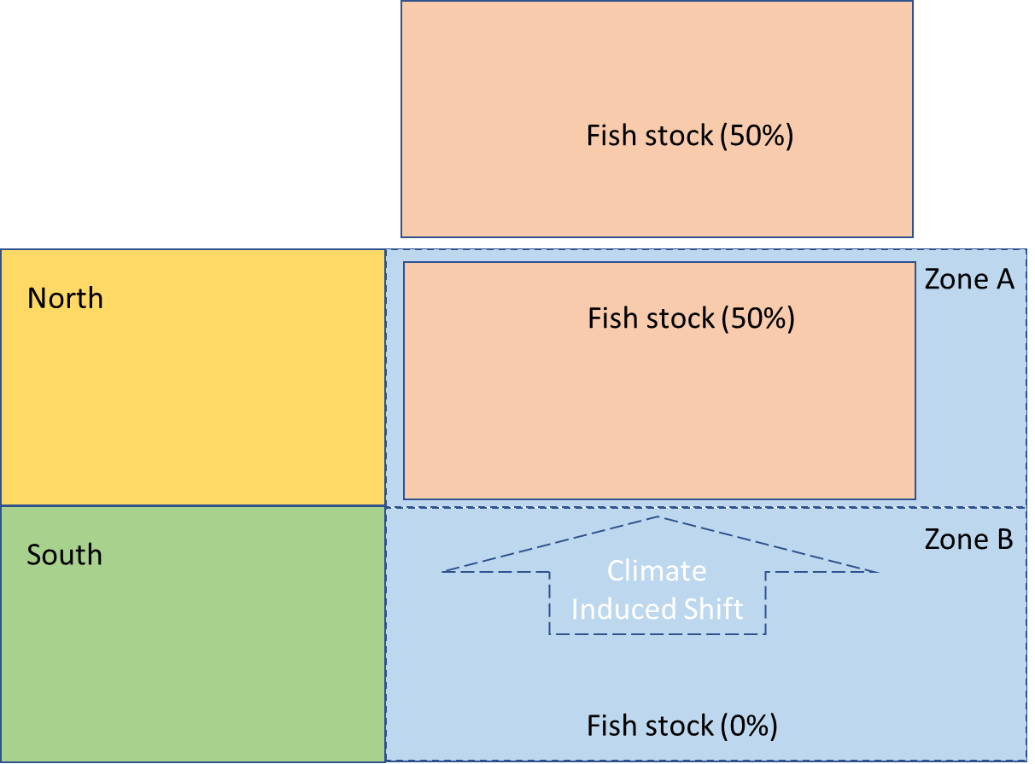
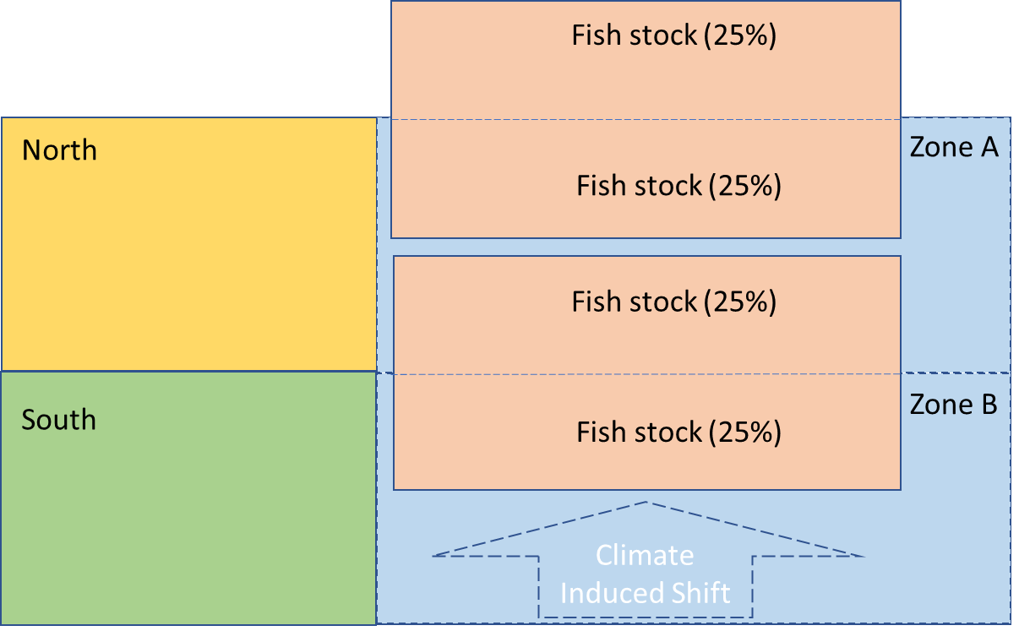
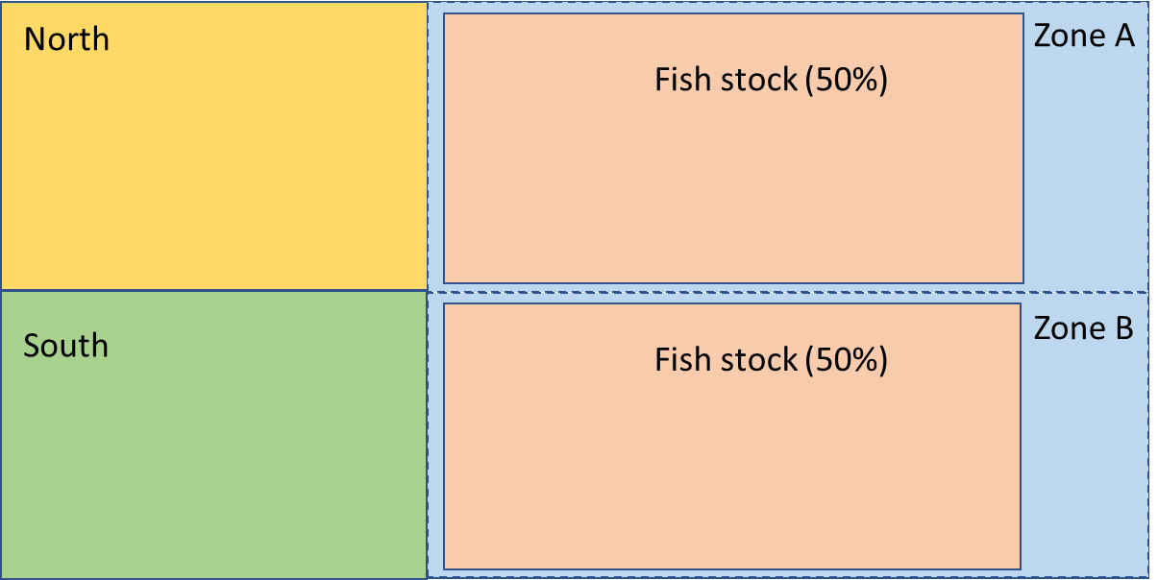
Focus: Climate Induced Stock Shift
How does changing sea temperatures affect fishing stock distributions and fishery management systems?
As water temperature increases, fish stocks move north into colder waters and fishing vessels must travel longer distances, which results in higher fuel cost.
These changes have implications on marine areas, to include:
Changes in vessel navigation and activity levels
Changing patterns and implications on safety of navigation
Changes to local economy and commerce
Even Distribution
Distribution Change
Shift of Fish Stock
Time
Notes:
IFET
National Marine Fisheries
Digital Humanitarians

